Slide 1
Relationship between volume and capacity
Miss L
Year 11 Essentials

Slide 2
Learning Intentions
Students will be able to
recognise relations between volume and capacity, recognising that
1${cm}^{3}$ = 1 mL and 1 $m^{3}$ = 1 kL

Slide 3
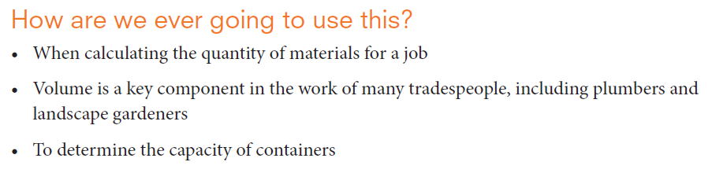


Slide 4
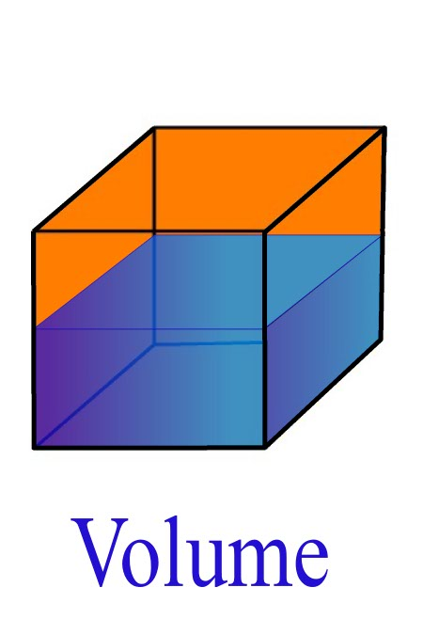
24
7
30
Volume and Capacity
Date
EQ – How do we convert units between volume and capacity?
What is Volume?
Volume is the amount of space inside a three-dimensional object.
Volume is measured in cubic units such as ${mm}^{3},{cm}^{3}$, $m^{3}$

Slide 5
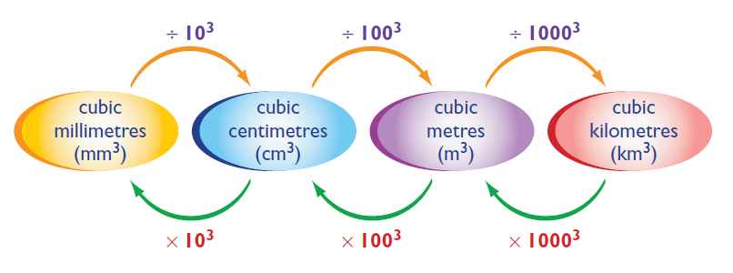
24
7
30
Volume and Capacity
Date
EQ – How do we convert units between volume and capacity?
÷ 1,000 ÷ 1,000,000 ÷ 1,000,000,000
x 1,000 x 1,000,000 x 1,000,000,000

Slide 6
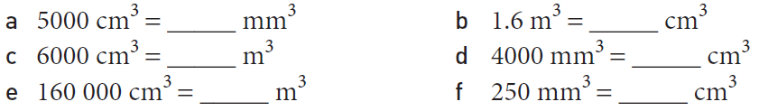
Practice

Slide 7
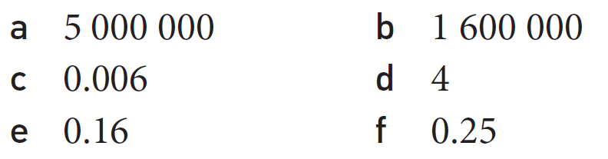

Slide 8


Slide 9

24
7
30
Volume and Capacity
Date
EQ – How do we convert units between volume and capacity?
Volume measures the amount of space inside a container while capacity measures the amount of liquid or gas a container will hold.
Measured in mL, L, kL and mL
What is Capacity?

Slide 10
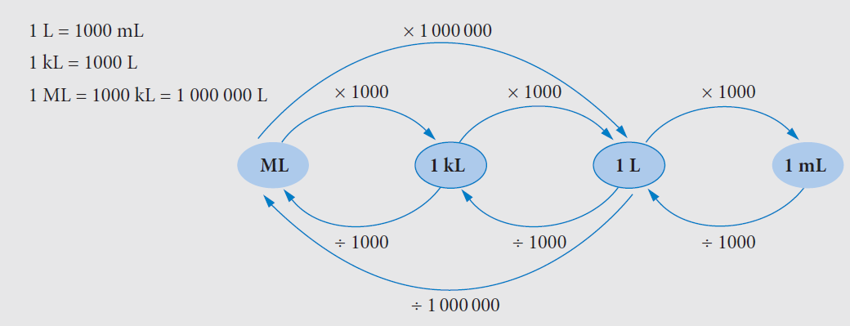
24
7
30
Volume and Capacity
Date
EQ – How do we convert units between volume and capacity?

Slide 11
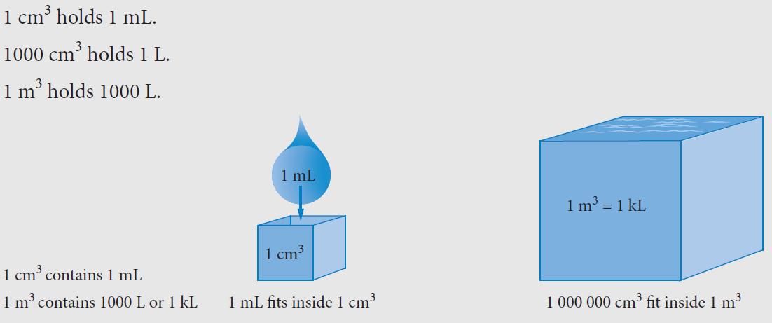
24
7
30
Volume and Capacity
Date
EQ – How do we convert units between volume and capacity?

Slide 12
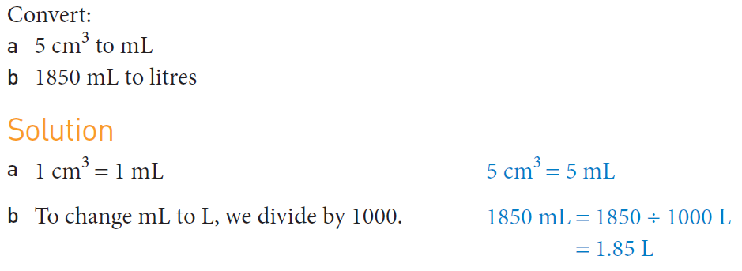
Practice

Slide 13
Task
50/50 worksheet

